Slide 1
Chapter 7: Relational Database Design

Slide 2
Chapter 7: Relational Database Design
First Normal Form
Pitfalls in Relational Database Design
Functional Dependencies
Decomposition
Boyce-Codd Normal Form
Third Normal Form
Multivalued Dependencies and Fourth Normal Form
Overall Database Design Process

Slide 3
First Normal Form
Domain is atomic if its elements are considered to be indivisible units
  Examples of non-atomic domains:
    Set of names, composite attributes
    Identification numbers like CS101 that can be broken up into parts
A relational schema R is in first normal form if the domains of all attributes of R are atomic
Non-atomic values complicate storage and encourage redundant (repeated) storage of data
  E.g. Set of accounts stored with each customer, and set of owners stored with each account
  We assume all relations are in first normal form (revisit this in Chapter 9 on Object Relational Databases)

Slide 4
First Normal Form (Contd.)
Atomicity is actually a property of how the elements of the domain are used.
  E.g. Strings would normally be considered indivisible
  Suppose that students are given roll numbers which are strings of the form CS0012 or EE1127
  If the first two characters are extracted to find the department, the domain of roll numbers is not atomic.
  Doing so is a bad idea: leads to encoding of information in application program rather than in the database.

Slide 5
Pitfalls in Relational Database Design
Relational database design requires that we find a “good” collection of relation schemas. A bad design may lead to
  Repetition of Information.
  Inability to represent certain information.
Design Goals:
  Avoid redundant data
  Ensure that relationships among attributes are represented
  Facilitate the checking of updates for violation of database integrity constraints.

Slide 6
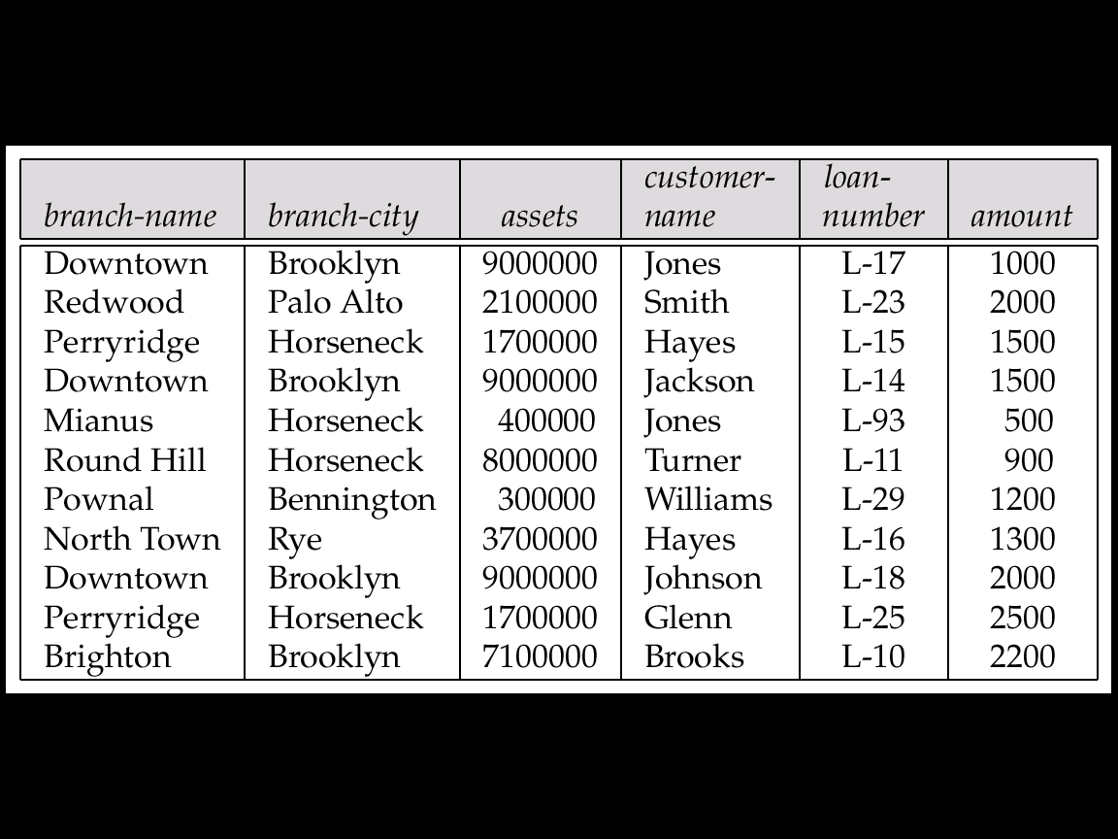
Example
Consider the relation schema:
Lending-schema = (branch-name, branch-city, assets,
customer-name, loan-number, amount)
Redundancy:
  Data for branch-name, branch-city, assets are repeated for each loan that a branch makes
  Wastes space
  Complicates updating, introducing possibility of inconsistency of assets value
Null values
  Cannot store information about a branch if no loans exist
  Can use null values, but they are difficult to handle.

Slide 7
Decomposition
Decompose the relation schema Lending-schema into:
Branch-schema = (branch-name, branch-city,assets)
Loan-info-schema = (customer-name, loan-number,
branch-name, amount)
All attributes of an original schema (R) must appear in the decomposition (R₁, R₂):
R = R₁ ∪ R₂
Lossless-join decomposition.
For all possible relations r on schema R
r = ∏_{R1} (r) ∏_{R2} (r)

Slide 8
Example of Non Lossless-Join Decomposition
Decomposition of R = (A, B)
R₂ = (A) R₂ = (B)
A
B
A
B
α
α
β
1
2
1
α
β
1
2
∏_{A}(r)
∏_{B(r)}
r
∏_{A} (r) ∏_{B} (r)
A
B
α
α
β
β
1
2
1
2

Slide 9
Goal — Devise a Theory for the Following
Decide whether a particular relation R is in “good” form.
In the case that a relation R is not in “good” form, decompose it into a set of relations {R₁, R₂, ..., R_{n}} such that
  each relation is in good form
  the decomposition is a lossless-join decomposition
Our theory is based on:
  functional dependencies
  multivalued dependencies

Slide 10
Functional Dependencies
Constraints on the set of legal relations.
Require that the value for a certain set of attributes determines uniquely the value for another set of attributes.
A functional dependency is a generalization of the notion of a key.

Slide 11
Functional Dependencies (Cont.)
Let R be a relation schema
α ⊆ R and β ⊆ R
The functional dependency
α → β
holds on R if and only if for any legal relations r(R), whenever any two tuples t₁ and t₂ of r agree on the attributes α, they also agree on the attributes β. That is,
t₁[α] = t₂ [α] ⇒ t₁[β ] = t₂ [β ]
Example: Consider r(A,B) with the following instance of r.
On this instance, A → B does NOT hold, but B → A does hold.
4
1 5
3 7

Slide 12
Functional Dependencies (Cont.)
K is a superkey for relation schema R if and only if K → R
K is a candidate key for R if and only if
  K → R, and
  for no α ⊂ K, α → R
Functional dependencies allow us to express constraints that cannot be expressed using superkeys. Consider the schema:
Loan-info-schema = (customer-name, loan-number,
branch-name, amount).
We expect this set of functional dependencies to hold:
loan-number → amount
loan-number → branch-name
but would not expect the following to hold:
loan-number → customer-name

Slide 13
Use of Functional Dependencies
We use functional dependencies to:
  test relations to see if they are legal under a given set of functional dependencies.
    If a relation r is legal under a set F of functional dependencies, we say that r satisfies F.
  specify constraints on the set of legal relations
    We say that F holds on R if all legal relations on R satisfy the set of functional dependencies F.
Note: A specific instance of a relation schema may satisfy a functional dependency even if the functional dependency does not hold on all legal instances.
  For example, a specific instance of Loan-schema may, by chance, satisfy
  loan-number → customer-name.

Slide 14
Functional Dependencies (Cont.)
A functional dependency is trivial if it is satisfied by all instances of a relation
  E.g.
    customer-name, loan-number → customer-name
    customer-name → customer-name
  In general, α → β is trivial if β ⊆ α

Slide 15
Closure of a Set of Functional Dependencies
Given a set F set of functional dependencies, there are certain other functional dependencies that are logically implied by F.
  E.g. If A → B and B → C, then we can infer that A → C
The set of all functional dependencies logically implied by F is the closure of F.
We denote the closure of F by F⁺.
We can find all of F⁺ by applying Armstrong’s Axioms:
  if β ⊆ α, then α → β (reflexivity)
  if α → β, then γ α → γ β (augmentation)
  if α → β, and β → γ, then α → γ (transitivity)
These rules are
  sound (generate only functional dependencies that actually hold) and
  complete (generate all functional dependencies that hold).

Slide 16
Example
R = (A, B, C, G, H, I)
F = { A → B
A → C
CG → H
CG → I
B → H}
some members of F⁺
  A → H
    by transitivity from A → B and B → H
  AG → I
    by augmenting A → C with G, to get AG → CG
    and then transitivity with CG → I
  CG → HI
    from CG → H and CG → I : “union rule” can be inferred from
      definition of functional dependencies, or
      Augmentation of CG → I to infer CG → CGI, augmentation of
      CG → H to infer CGI → HI, and then transitivity

Slide 17
Procedure for Computing F⁺
To compute the closure of a set of functional dependencies F:
F⁺ = F
repeat
for each functional dependency f in F⁺
apply reflexivity and augmentation rules on f
add the resulting functional dependencies to F⁺
for each pair of functional dependencies f₁and f₂ in F⁺
if f₁ and f₂ can be combined using transitivity
then add the resulting functional dependency to F⁺
until F⁺ does not change any further
NOTE: We will see an alternative procedure for this task later

Slide 18
Closure of Functional Dependencies (Cont.)
We can further simplify manual computation of F⁺ by using the following additional rules.
  If α → β holds and α → γ holds, then α → β γ holds (union)
  If α → β γ holds, then α → β holds and α → γ holds (decomposition)
  If α → β holds and γ β → δ holds, then α γ → δ holds (pseudotransitivity)
  The above rules can be inferred from Armstrong’s axioms.

Slide 19
Closure of Attribute Sets
Given a set of attributes α, define the closure of α under F (denoted by α⁺) as the set of attributes that are functionally determined by α under F:
α → β is in F⁺ ⬄ β ⊆ α⁺
Algorithm to compute α⁺, the closure of α under F
result := α;
while (changes to result) do
for each β → γ in F do
begin
if β ⊆ result then result := result ∪ γ
end

Slide 20
Example of Attribute Set Closure
R = (A, B, C, G, H, I)
F = {A → B
A → C
CG → H
CG → I
B → H}
(AG)⁺
  1. result = AG
  2. result = ABCG (A → C and A → B)
  3. result = ABCGH (CG → H and CG ⊆ AGBC)
  4. result = ABCGHI (CG → I and CG ⊆ AGBCH)
Is AG a candidate key?
  Is AG a super key?
    Does AG → R? == Is (AG)⁺ ⊇ R
  Is any subset of AG a superkey?
    Does A → R? == Is (A)⁺ ⊇ R
    Does G → R? == Is (G)⁺ ⊇ R

Slide 21
Uses of Attribute Closure
There are several uses of the attribute closure algorithm:
Testing for superkey:
  To test if α is a superkey, we compute α^{+,} and check if α⁺ contains all attributes of R.
Testing functional dependencies
  To check if a functional dependency α → β holds (or, in other words, is in F⁺), just check if β ⊆ α⁺.
  That is, we compute α⁺ by using attribute closure, and then check if it contains β.
  Is a simple and cheap test, and very useful
Computing closure of F
  For each γ ⊆ R, we find the closure γ⁺, and for each S ⊆ γ⁺, we output a functional dependency γ → S.

Slide 22
Canonical Cover
Sets of functional dependencies may have redundant dependencies that can be inferred from the others
  Eg: A → C is redundant in: {A → B, B → C, A → C}
  Parts of a functional dependency may be redundant
    E.g. on RHS: {A → B, B → C, A → CD} can be simplified to
    {A → B, B → C, A → D}
    E.g. on LHS: {A → B, B → C, AC → D} can be simplified to
    {A → B, B → C, A → D}
Intuitively, a canonical cover of F is a “minimal” set of functional dependencies equivalent to F, having no redundant dependencies or redundant parts of dependencies

Slide 23
Extraneous Attributes
Consider a set F of functional dependencies and the functional dependency α → β in F.
  Attribute A is extraneous in α if A ∈ α
  and F logically implies (F – {α → β}) ∪ {(α – A) → β}.
  Attribute A is extraneous in β if A ∈ β
  and the set of functional dependencies
  (F – {α → β}) ∪ {α →(β – A)} logically implies F.
Note: implication in the opposite direction is trivial in each of the cases above, since a “stronger” functional dependency always implies a weaker one
Example: Given F = {A → C, AB → C }
  B is extraneous in AB → C because {A → C, AB → C} logically implies A → C (I.e. the result of dropping B from AB → C).
Example: Given F = {A → C, AB → CD}
  C is extraneous in AB → CD since AB → C can be inferred even after deleting C

Slide 24
Testing if an Attribute is Extraneous
Consider a set F of functional dependencies and the functional dependency α → β in F.
To test if attribute A ∈ α is extraneous in α
  compute ({α} – A)⁺ using the dependencies in F
  check that ({α} – A)⁺ contains A; if it does, A is extraneous
To test if attribute A ∈ β is extraneous in β
  compute α⁺ using only the dependencies in
  F’ = (F – {α → β}) ∪ {α →(β – A)},
  check that α⁺ contains A; if it does, A is extraneous

Slide 25
Canonical Cover
A canonical cover for F is a set of dependencies F_{c} such that
  F logically implies all dependencies in F_{c,} and
  F_{c} logically implies all dependencies in F, and
  No functional dependency in F_{c} contains an extraneous attribute, and
  Each left side of functional dependency in F_{c} is unique.
To compute a canonical cover for F:
repeat
Use the union rule to replace any dependencies in F
α₁ → β₁ and α₁ → β₁ with α₁ → β₁ β₂
Find a functional dependency α → β with an
extraneous attribute either in α or in β
If an extraneous attribute is found, delete it from α → β
until F does not change
Note: Union rule may become applicable after some extraneous attributes have been deleted, so it has to be re-applied

Slide 26
Example of Computing a Canonical Cover
R = (A, B, C)
F = {A → BC
B → C
A → B
AB → C}
Combine A → BC and A → B into A → BC
  Set is now {A → BC, B → C, AB → C}
A is extraneous in AB → C
  Check if the result of deleting A from AB → C is implied by the other dependencies
    Yes: in fact, B → C is already present!
  Set is now {A → BC, B → C}
C is extraneous in A → BC
  Check if A → C is logically implied by A → B and the other dependencies
    Yes: using transitivity on A → B and B → C.
      Can use attribute closure of A in more complex cases
The canonical cover is: A → B
B → C

Slide 27
Goals of Normalization
Decide whether a particular relation R is in “good” form.
In the case that a relation R is not in “good” form, decompose it into a set of relations {R₁, R₂, ..., R_{n}} such that
  each relation is in good form
  the decomposition is a lossless-join decomposition
Our theory is based on:
  functional dependencies
  multivalued dependencies

Slide 28
Decomposition
Decompose the relation schema Lending-schema into:
Branch-schema = (branch-name, branch-city,assets)
Loan-info-schema = (customer-name, loan-number,
branch-name, amount)
All attributes of an original schema (R) must appear in the decomposition (R₁, R₂):
R = R₁ ∪ R₂
Lossless-join decomposition.
For all possible relations r on schema R
r = ∏_{R1} (r) ∏_{R2} (r)
A decomposition of R into R₁ and R₂ is lossless join if and only if at least one of the following dependencies is in F⁺:
  R₁ ∩ R₂ → R₁
  R₁ ∩ R₂ → R₂

Slide 29
Example of Lossy-Join Decomposition
Lossy-join decompositions result in information loss.
Example: Decomposition of R = (A, B)
R₂ = (A) R₂ = (B)
A
B
A
B
α
α
β
1
2
1
α
β
1
2
∏_{A}(r)
∏_{B(r)}
r
∏_{A} (r) ∏_{B} (r)
A
B
α
α
β
β
1
2
1
2

Slide 30
Normalization Using Functional Dependencies
When we decompose a relation schema R with a set of functional dependencies F into R₁, R₂,.., R_{n} we want
  Lossless-join decomposition: Otherwise decomposition would result in information loss.
  No redundancy: The relations R_{i} preferably should be in either Boyce-Codd Normal Form or Third Normal Form.
  Dependency preservation: Let F_{i} be the set of dependencies F⁺ that include only attributes in R_{i}.
    Preferably the decomposition should be dependency preserving, that is, (F₁ ∪ F₂ ∪ … ∪ F_{n})⁺ = F⁺
    Otherwise, checking updates for violation of functional dependencies may require computing joins, which is expensive.

Slide 31

Example
R = (A, B, C)
F = {A → B, B → C)
  Can be decomposed in two different ways
R₁ = (A, B), R₂ = (B, C)
  Lossless-join decomposition:
  R₁ ∩ R₂ = {B} and B → BC
  Dependency preserving
R₁ = (A, B), R₂ = (A, C)
  Lossless-join decomposition:
  R₁ ∩ R₂ = {A} and A → AB
  Not dependency preserving
  (cannot check B → C without computing R₁ R₂)

Slide 32
Testing for Dependency Preservation
To check if a dependency α→β is preserved in a decomposition of R into R₁, R₂, …, R_{n} we apply the following simplified test (with attribute closure done w.r.t. F)
  result = α
  while (changes to result) do
  for each R_{i} in the decomposition
  t = (result ∩ R_{i})⁺ ∩ R_{i}
  result = result ∪ t
  If result contains all attributes in β, then the functional dependency
  α → β is preserved.
We apply the test on all dependencies in F to check if a decomposition is dependency preserving
This procedure takes polynomial time, instead of the exponential time required to compute F⁺ and (F₁ ∪ F₂ ∪ … ∪ F_{n})⁺

Slide 33
Boyce-Codd Normal Form
A relation schema R is in BCNF with respect to a set F of functional
dependencies if for all functional dependencies in F⁺ of the form
α → β, where α ⊆ R and β ⊆ R, at least one of the following holds:
α  → β is trivial (i.e., β ⊆ α)
α is a superkey for R

Slide 34
Example
R = (A, B, C)
F = {A → B
B → C}
Key = {A}
R is not in BCNF
Decomposition R₁ = (A, B), R₂ = (B, C)
  R₁ and R₂ in BCNF
  Lossless-join decomposition
  Dependency preserving

Slide 35
Testing for BCNF
To check if a non-trivial dependency α →β causes a violation of BCNF
  1. compute α⁺ (the attribute closure of α), and
  2. verify that it includes all attributes of R, that is, it is a superkey of R.
Simplified test: To check if a relation schema R is in BCNF, it suffices to check only the dependencies in the given set F for violation of BCNF, rather than checking all dependencies in F⁺.
  If none of the dependencies in F causes a violation of BCNF, then none of the dependencies in F⁺ will cause a violation of BCNF either.
However, using only F is incorrect when testing a relation in a decomposition of R
  E.g. Consider R (A, B, C, D), with F = { A →B, B →C}
    Decompose R into R₁(A,B) and R₂(A,C,D)
    Neither of the dependencies in F contain only attributes from
    (A,C,D) so we might be mislead into thinking R₂ satisfies BCNF.
    In fact, dependency A → C in F⁺ shows R₂ is not in BCNF.

Slide 36
BCNF Decomposition Algorithm
result := {R};
done := false;
compute F⁺;
while (not done) do
if (there is a schema R_{i} in result that is not in BCNF)
then begin
let α  → β be a nontrivial functional
dependency that holds on R_{i}
such that α  → R_{i} is not in F⁺,
and α ∩ β = ∅;
result := (result – R_{i} ) ∪ (R_{i} – β) ∪ (α, β );
end
else done := true;
Note: each R_{i} is in BCNF, and decomposition is lossless-join.

Slide 37
Example of BCNF Decomposition
R = (branch-name, branch-city, assets,
  customer-name, loan-number, amount)
  F = {branch-name → assets branch-city
  loan-number → amount branch-name}
  Key = {loan-number, customer-name}
Decomposition
  R₁ = (branch-name, branch-city, assets)
  R₂ = (branch-name, customer-name, loan-number, amount)
  R₃ = (branch-name, loan-number, amount)
  R₄ = (customer-name, loan-number)
Final decomposition
R₁, R₃, R₄

Slide 38
Testing Decomposition for BCNF
To check if a relation R_{i} in a decomposition of R is in BCNF,
  Either test R_{i} for BCNF with respect to the restriction of F to R_{i} (that is, all FDs in F⁺ that contain only attributes from R_{i})
  or use the original set of dependencies F that hold on R, but with the following test:
      for every set of attributes α ⊆ R_{i}, check that α⁺ (the attribute closure of α) either includes no attribute of R_{i}- α, or includes all attributes of R_{i}.
    If the condition is violated by some α → β in F, the dependency
    α → (α⁺ - α ) ∩ R_{i}
    can be shown to hold on R_{i}, and R_{i} violates BCNF.
    We use above dependency to decompose R_{i}

Slide 39
BCNF and Dependency Preservation
It is not always possible to get a BCNF decomposition that is
dependency preserving
R = (J, K, L)
F = {JK → L
L → K}
Two candidate keys = JK and JL
R is not in BCNF
Any decomposition of R will fail to preserve
JK → L

Slide 40
Third Normal Form: Motivation
There are some situations where
  BCNF is not dependency preserving, and
  efficient checking for FD violation on updates is important
Solution: define a weaker normal form, called Third Normal Form.
  Allows some redundancy (with resultant problems; we will see examples later)
  But FDs can be checked on individual relations without computing a join.
  There is always a lossless-join, dependency-preserving decomposition into 3NF.

Slide 41
Third Normal Form
A relation schema R is in third normal form (3NF) if for all:
α → β in F⁺
at least one of the following holds:
  α → β is trivial (i.e., β ∈ α)
  α is a superkey for R
  Each attribute A in β – α is contained in a candidate key for R.
  (NOTE: each attribute may be in a different candidate key)
If a relation is in BCNF it is in 3NF (since in BCNF one of the first two conditions above must hold).
Third condition is a minimal relaxation of BCNF to ensure dependency preservation (will see why later).

Slide 42
3NF (Cont.)
Example
  R = (J, K, L)
  F = {JK → L, L → K}
  Two candidate keys: JK and JL
  R is in 3NF
  JK → L JK is a superkey
  L → K K is contained in a candidate key
  BCNF decomposition has (JL) and (LK)
    Testing for JK → L requires a join
There is some redundancy in this schema
Equivalent to example in book:
  Banker-schema = (branch-name, customer-name, banker-name)
  banker-name → branch name
  branch name customer-name → banker-name

Slide 43
Testing for 3NF
Optimization: Need to check only FDs in F, need not check all FDs in F⁺.
Use attribute closure to check for each dependency α → β, if α is a superkey.
If α is not a superkey, we have to verify if each attribute in β is contained in a candidate key of R
  this test is rather more expensive, since it involve finding candidate keys
  testing for 3NF has been shown to be NP-hard
  Interestingly, decomposition into third normal form (described shortly) can be done in polynomial time

Slide 44
3NF Decomposition Algorithm
Let F_{c} be a canonical cover for F;
i := 0;
for each functional dependency α → β in F_{c} do
if none of the schemas R_{j}, 1 ≤ j ≤ i contains α β
then begin
i := i + 1;
R_{i} := α β
end
if none of the schemas R_{j}, 1 ≤ j ≤ i contains a candidate key for R
then begin
i := i + 1;
R_{i} := any candidate key for R;
end
return (R₁, R₂, ..., R_{i})

Slide 45
3NF Decomposition Algorithm (Cont.)
Above algorithm ensures:
  each relation schema R_{i} is in 3NF
  decomposition is dependency preserving and lossless-join
  Proof of correctness is at end of this file (click here)

Slide 46
Example
Relation schema:
  Banker-info-schema = (branch-name, customer-name,
  banker-name, office-number)
The functional dependencies for this relation schema are:
banker-name → branch-name office-number
customer-name branch-name → banker-name
The key is:
{customer-name, branch-name}

Slide 47
Applying 3NF to Banker-info-schema
The for loop in the algorithm causes us to include the following schemas in our decomposition:
Banker-office-schema = (banker-name, branch-name,
office-number)
Banker-schema = (customer-name, branch-name,
banker-name)
Since Banker-schema contains a candidate key for
Banker-info-schema, we are done with the decomposition process.

Slide 48
Comparison of BCNF and 3NF
It is always possible to decompose a relation into relations in 3NF and
  the decomposition is lossless
  the dependencies are preserved
It is always possible to decompose a relation into relations in BCNF and
  the decomposition is lossless
  it may not be possible to preserve dependencies.

Slide 49
Comparison of BCNF and 3NF (Cont.)
Example of problems due to redundancy in 3NF
  R = (J, K, L)
  F = {JK → L, L → K}
J
L
K
j₁
j₂
j₃
null
l₁
l₁
l₁
l₂
k₁
k₁
k₁
k₂
A schema that is in 3NF but not in BCNF has the problems of
repetition of information (e.g., the relationship l₁, k₁)
need to use null values (e.g., to represent the relationship
l₂, k₂ where there is no corresponding value for J).

Slide 50
Design Goals
Goal for a relational database design is:
  BCNF.
  Lossless join.
  Dependency preservation.
If we cannot achieve this, we accept one of
  Lack of dependency preservation
  Redundancy due to use of 3NF
Interestingly, SQL does not provide a direct way of specifying functional dependencies other than superkeys.
Can specify FDs using assertions, but they are expensive to test
Even if we had a dependency preserving decomposition, using SQL we would not be able to efficiently test a functional dependency whose left hand side is not a key.

Slide 51
Testing for FDs Across Relations
If decomposition is not dependency preserving, we can have an extra materialized view for each dependency α →β in F_{c} that is not preserved in the decomposition
The materialized view is defined as a projection on α β of the join of the relations in the decomposition
Many newer database systems support materialized views and database system maintains the view when the relations are updated.
  No extra coding effort for programmer.
The functional dependency α → β is expressed by declaring α as a candidate key on the materialized view.
Checking for candidate key cheaper than checking α → β
BUT:
  Space overhead: for storing the materialized view
  Time overhead: Need to keep materialized view up to date when
  relations are updated
  Database system may not support key declarations on
  materialized views

Slide 52
Multivalued Dependencies
There are database schemas in BCNF that do not seem to be sufficiently normalized
Consider a database
classes(course, teacher, book)
such that (c,t,b) ∈ classes means that t is qualified to teach c, and b is a required textbook for c
The database is supposed to list for each course the set of teachers any one of which can be the course’s instructor, and the set of books, all of which are required for the course (no matter who teaches it).

Slide 53
Multivalued Dependencies (Cont.)
course
teacher
book
database
database
database
database
database
database
operating systems
operating systems
operating systems
operating systems
Avi
Avi
Hank
Hank
Sudarshan
Sudarshan
Avi
Avi
Jim
Jim
DB Concepts
Ullman
DB Concepts
Ullman
DB Concepts
Ullman
OS Concepts
Shaw
OS Concepts
Shaw
classes
There are no non-trivial functional dependencies and therefore the relation is in BCNF
Insertion anomalies – i.e., if Sara is a new teacher that can teach database, two tuples need to be inserted
(database, Sara, DB Concepts)
(database, Sara, Ullman)

Slide 54
Multivalued Dependencies (Cont.)
Therefore, it is better to decompose classes into:
course
teacher
database
database
database
operating systems
operating systems
Avi
Hank
Sudarshan
Avi
Jim
teaches
course
book
database
database
operating systems
operating systems
DB Concepts
Ullman
OS Concepts
Shaw
text
We shall see that these two relations are in Fourth Normal Form (4NF)

Slide 55
Multivalued Dependencies (MVDs)
Let R be a relation schema and let α ⊆ R and β ⊆ R. The multivalued dependency
α →→ β
holds on R if in any legal relation r(R), for all pairs for tuples t₁ and t₂ in r such that t₁[α] = t₂ [α], there exist tuples t₃ and t₄ in r such that:
t₁[α] = t₂ [α] = t₃ [α] t₄ [α]
t₃[β] = t₁ [β]
t₃[R – β] = t₂[R – β]
t₄ [β] = t₂[β]
t₄[R – β] = t₁[R – β]

Slide 56
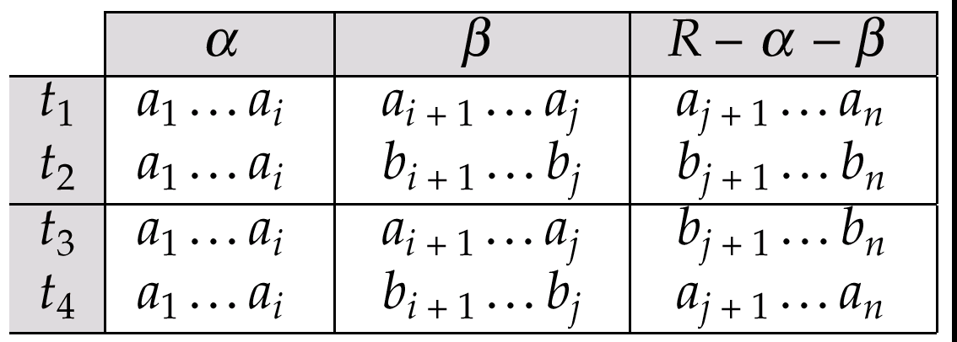
MVD (Cont.)
Tabular representation of α →→ β

Slide 57
Example
Let R be a relation schema with a set of attributes that are partitioned into 3 nonempty subsets.
Y, Z, W
We say that Y →→ Z (Y multidetermines Z)
if and only if for all possible relations r(R)
< y₁, z₁, w₁ > ∈ r and < y₂, z₂, w₂ > ∈ r
then
< y₁, z₁, w₂ > ∈ r and < y₂, z₂, w₁ > ∈ r
Note that since the behavior of Z and W are identical it follows that Y →→ Z if Y →→ W

Slide 58
Example (Cont.)
In our example:
course →→ teacher
course →→ book
The above formal definition is supposed to formalize the notion that given a particular value of Y (course) it has associated with it a set of values of Z (teacher) and a set of values of W (book), and these two sets are in some sense independent of each other.
Note:
  If Y → Z then Y →→ Z
  Indeed we have (in above notation) Z₁ = Z₂
  The claim follows.

Slide 59
Use of Multivalued Dependencies
We use multivalued dependencies in two ways:
  1. To test relations to determine whether they are legal under a given set of functional and multivalued dependencies
  2. To specify constraints on the set of legal relations. We shall thus concern ourselves only with relations that satisfy a given set of functional and multivalued dependencies.
If a relation r fails to satisfy a given multivalued dependency, we can construct a relations r′ that does satisfy the multivalued dependency by adding tuples to r.

Slide 60
Theory of MVDs
From the definition of multivalued dependency, we can derive the following rule:
  If α → β, then α →→ β
That is, every functional dependency is also a multivalued dependency
The closure D⁺ of D is the set of all functional and multivalued dependencies logically implied by D.
  We can compute D⁺ from D, using the formal definitions of functional dependencies and multivalued dependencies.
  We can manage with such reasoning for very simple multivalued dependencies, which seem to be most common in practice
  For complex dependencies, it is better to reason about sets of dependencies using a system of inference rules (see Appendix C).

Slide 61
Fourth Normal Form
A relation schema R is in 4NF with respect to a set D of functional and multivalued dependencies if for all multivalued dependencies in D⁺ of the form α →→ β, where α ⊆ R and β ⊆ R, at least one of the following hold:
  α →→ β is trivial (i.e., β ⊆ α or α ∪ β = R)
  α is a superkey for schema R
If a relation is in 4NF it is in BCNF

Slide 62
Restriction of Multivalued Dependencies
The restriction of D to R_{i} is the set D_{i} consisting of
  All functional dependencies in D⁺ that include only attributes of R_{i}
  All multivalued dependencies of the form
    α →→ (β ∩ R_{i})
  where α ⊆ R_{i} and α →→ β is in D⁺

Slide 63
4NF Decomposition Algorithm
result: = {R};
done := false;
compute D⁺;
Let D_{i} denote the restriction of D⁺ to R_{i}
while (not done)
if (there is a schema R_{i} in result that is not in 4NF) then
begin
let α →→ β be a nontrivial multivalued dependency that holds
on R_{i} such that α → R_{i} is not in D_{i}, and α∩β=φ;
result := (result - R_{i}) ∪ (R_{i} - β) ∪ (α, β);
end
else done:= true;
Note: each R_{i} is in 4NF, and decomposition is lossless-join

Slide 64
Example
R =(A, B, C, G, H, I)
F ={ A →→ B
B →→ HI
CG →→ H }
R is not in 4NF since A →→ B and A is not a superkey for R
Decomposition
a) R₁ = (A, B) (R₁ is in 4NF)
b) R₂ = (A, C, G, H, I) (R₂ is not in 4NF)
c) R₃ = (C, G, H) (R₃ is in 4NF)
d) R₄ = (A, C, G, I) (R₄ is not in 4NF)
Since A →→ B and B →→ HI, A →→ HI, A →→ I
e) R₅ = (A, I) (R₅ is in 4NF)
f)R₆ = (A, C, G) (R₆ is in 4NF)

Slide 65
Further Normal Forms
Join dependencies generalize multivalued dependencies
  lead to project-join normal form (PJNF) (also called fifth normal form)
A class of even more general constraints, leads to a normal form called domain-key normal form.
Problem with these generalized constraints: are hard to reason with, and no set of sound and complete set of inference rules exists.
Hence rarely used

Slide 66
Overall Database Design Process
We have assumed schema R is given
  R could have been generated when converting E-R diagram to a set of tables.
  R could have been a single relation containing all attributes that are of interest (called universal relation).
  Normalization breaks R into smaller relations.
  R could have been the result of some ad hoc design of relations, which we then test/convert to normal form.

Slide 67
ER Model and Normalization
When an E-R diagram is carefully designed, identifying all entities correctly, the tables generated from the E-R diagram should not need further normalization.
However, in a real (imperfect) design there can be FDs from non-key attributes of an entity to other attributes of the entity
E.g. employee entity with attributes department-number and department-address, and an FD department-number → department-address
  Good design would have made department an entity
FDs from non-key attributes of a relationship set possible, but rare --- most relationships are binary

Slide 68
Universal Relation Approach
Dangling tuples – Tuples that “disappear” in computing a join.
  Let r₁ (R₁), r₂ (R₂), …., r_{n} (R_{n}) be a set of relations
  A tuple r of the relation r_{i} is a dangling tuple if r is not in the relation:
  ∏_{Ri} (r₁ r₂ … r_{n})
The relation r₁ r₂ … r_{n} is called a universal relation since it involves all the attributes in the “universe” defined by
  R₁ ∪ R₂ ∪ … ∪ R_{n}
If dangling tuples are allowed in the database, instead of decomposing a universal relation, we may prefer to synthesize a collection of normal form schemas from a given set of attributes.

Slide 69
Universal Relation Approach
Dangling tuples may occur in practical database applications.
They represent incomplete information
E.g. may want to break up information about loans into:
  (branch-name, loan-number)
  (loan-number, amount)
  (loan-number, customer-name)
Universal relation would require null values, and have dangling tuples

Slide 70
Universal Relation Approach (Contd.)
A particular decomposition defines a restricted form of incomplete information that is acceptable in our database.
  Above decomposition requires at least one of customer-name, branch-name or amount in order to enter a loan number without using null values
  Rules out storing of customer-name, amount without an appropriate loan-number (since it is a key, it can't be null either!)
Universal relation requires unique attribute names unique role assumption
  e.g. customer-name, branch-name
Reuse of attribute names is natural in SQL since relation names can be prefixed to disambiguate names

Slide 71
Denormalization for Performance
May want to use non-normalized schema for performance
E.g. displaying customer-name along with account-number and balance requires join of account with depositor
Alternative 1: Use denormalized relation containing attributes of account as well as depositor with all above attributes
  faster lookup
  Extra space and extra execution time for updates
  extra coding work for programmer and possibility of error in extra code
Alternative 2: use a materialized view defined as
account depositor
  Benefits and drawbacks same as above, except no extra coding work for programmer and avoids possible errors

Slide 72
Other Design Issues
Some aspects of database design are not caught by normalization
Examples of bad database design, to be avoided:
Instead of earnings(company-id, year, amount), use
  earnings-2000, earnings-2001, earnings-2002, etc., all on the schema (company-id, earnings).
    Above are in BCNF, but make querying across years difficult and needs new table each year
  company-year(company-id, earnings-2000, earnings-2001,
  earnings-2002)
    Also in BCNF, but also makes querying across years difficult and requires new attribute each year.
    Is an example of a crosstab, where values for one attribute become column names
    Used in spreadsheets, and in data analysis tools

Slide 73
Proof of Correctness of 3NF Decomposition Algorithm

Slide 74
Correctness of 3NF Decomposition Algorithm
3NF decomposition algorithm is dependency preserving (since there is a relation for every FD in F_{c})
Decomposition is lossless join
  A candidate key (C) is in one of the relations R_{i} in decomposition
  Closure of candidate key under F_{c} must contain all attributes in R.
  Follow the steps of attribute closure algorithm to show there is only one tuple in the join result for each tuple in R_{i}

Slide 75
Correctness of 3NF Decomposition Algorithm (Contd.)
Claim: if a relation R_{i} is in the decomposition generated by the
above algorithm, then R_{i} satisfies 3NF.
Let R_{i} be generated from the dependency α →β
Let γ → B be any non-trivial functional dependency on R_{i}. (We need only consider FDs whose right-hand side is a single attribute.)
Now, B can be in either β or α but not in both. Consider each case separately.

Slide 76
Correctness of 3NF Decomposition (Contd.)
Case 1: If B in β:
  If γ is a superkey, the 2nd condition of 3NF is satisfied
  Otherwise α must contain some attribute not in γ
  Since γ → B is in F⁺ it must be derivable from F_{c}, by using attribute closure on γ.
  Attribute closure not have used α →β - if it had been used, α must be contained in the attribute closure of γ, which is not possible, since we assumed γ is not a superkey.
  Now, using α→ (β- {B}) and γ → B, we can derive α →B
  (since γ ⊆ α β, and B ∉ γ since γ → B is non-trivial)
  Then, B is extraneous in the right-hand side of α →β; which is not possible since α →β is in F_{c}.
  Thus, if B is in β then γ must be a superkey, and the second condition of 3NF must be satisfied.

Slide 77
Correctness of 3NF Decomposition (Contd.)
Case 2: B is in α.
  Since α is a candidate key, the third alternative in the definition of 3NF is trivially satisfied.
  In fact, we cannot show that γ is a superkey.
  This shows exactly why the third alternative is present in the definition of 3NF.
Q.E.D.

Slide 78
End of Chapter

Slide 79
Sample lending Relation

Slide 80
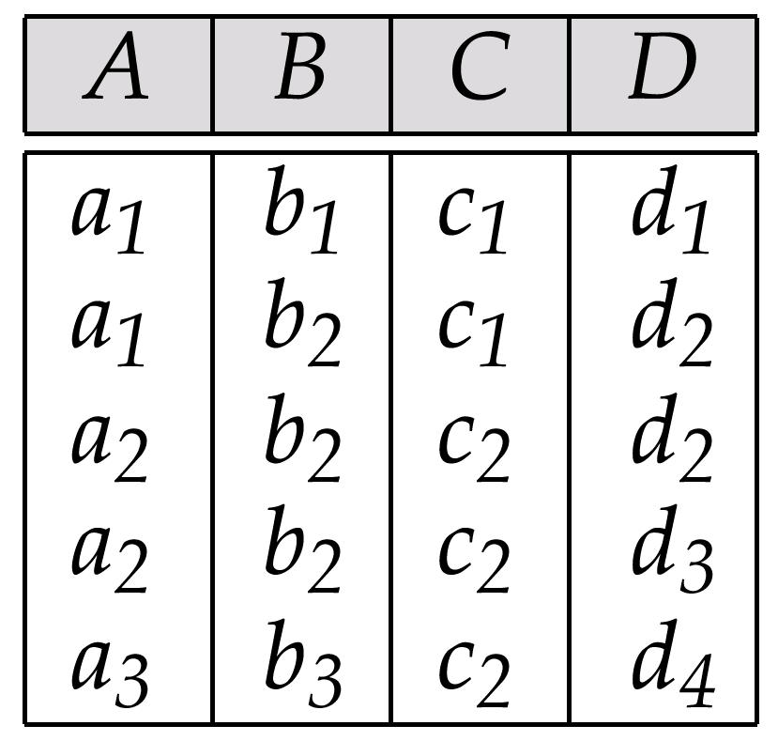
Sample Relation r

Slide 81
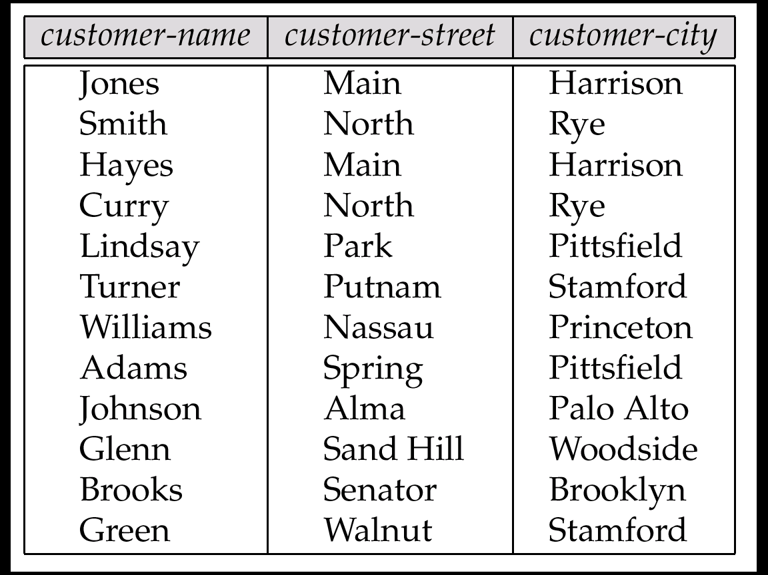
The customer Relation

Slide 82
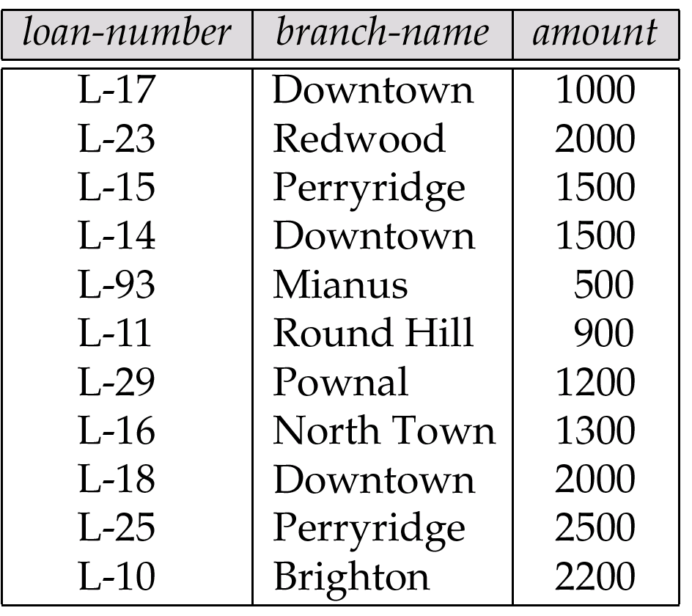
The loan Relation

Slide 83
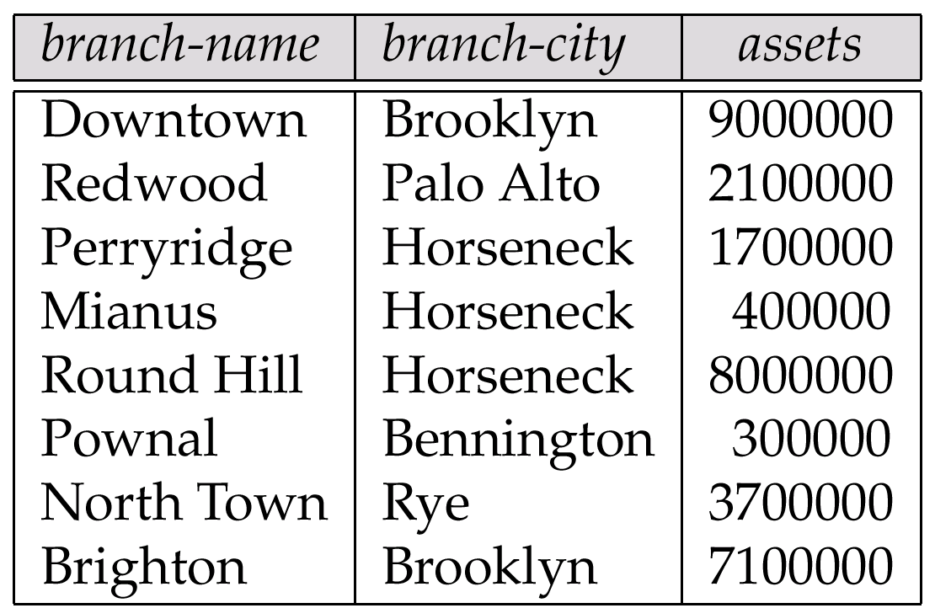
The branch Relation

Slide 84
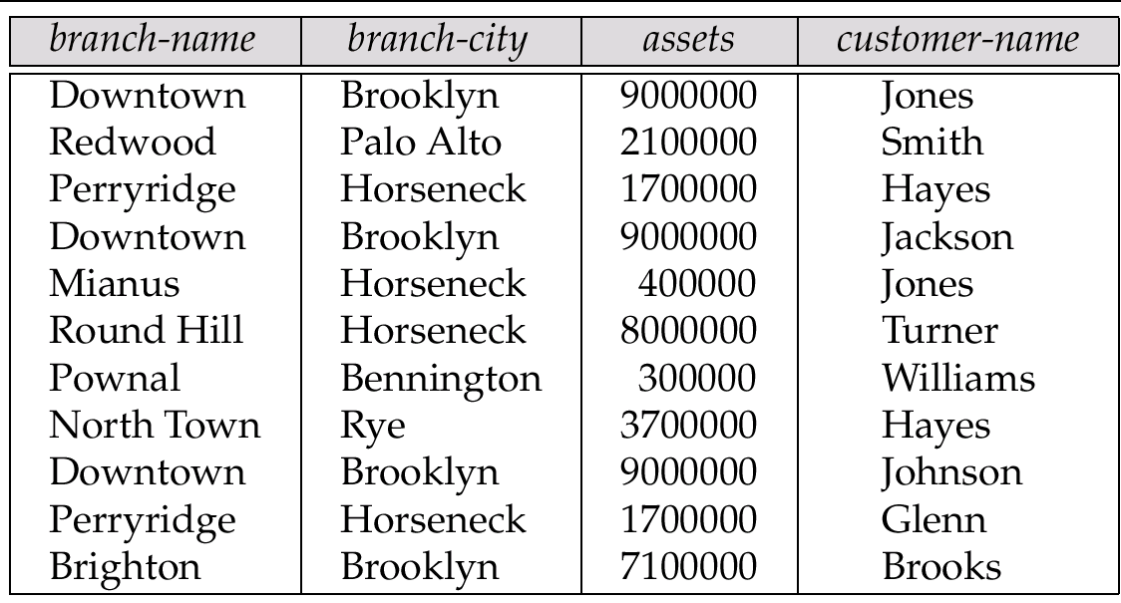
The Relation branch-customer

Slide 85
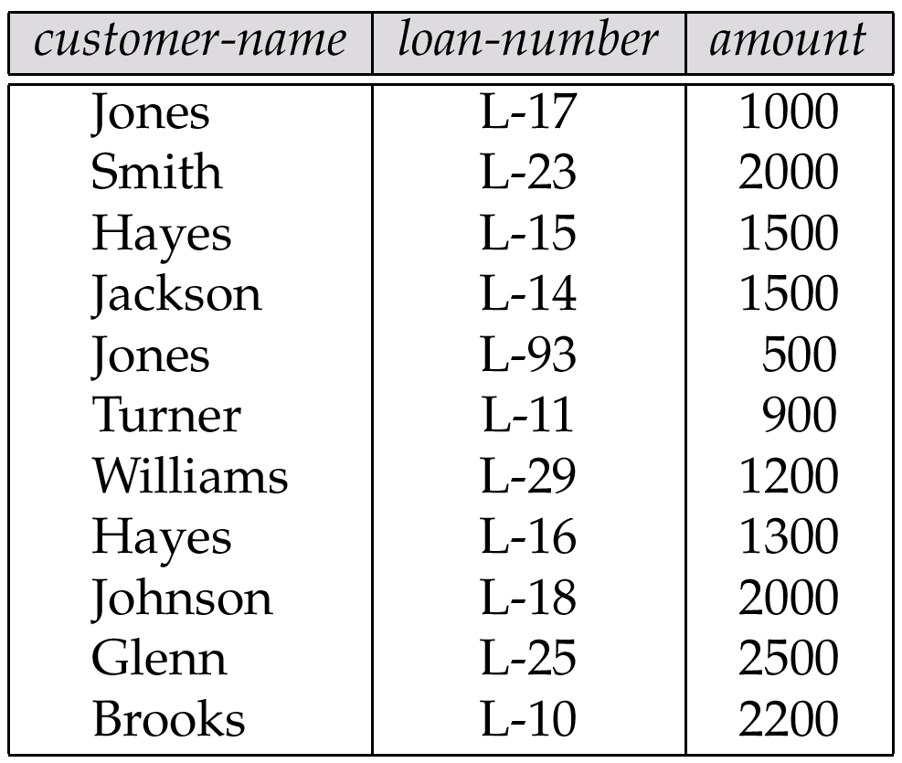
The Relation customer-loan

Slide 86
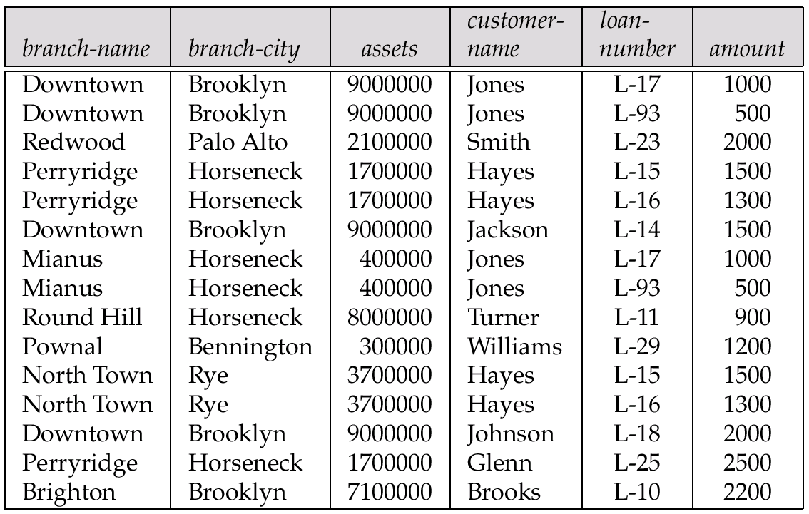
The Relation branch-customer customer-loan

Slide 87
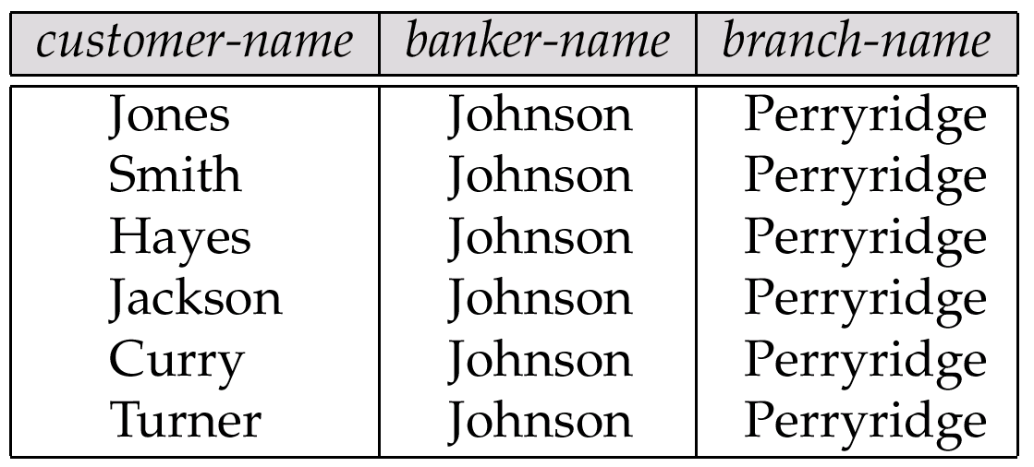
An Instance of Banker-schema

Slide 88
Tabular Representation of α →→ β

Slide 89
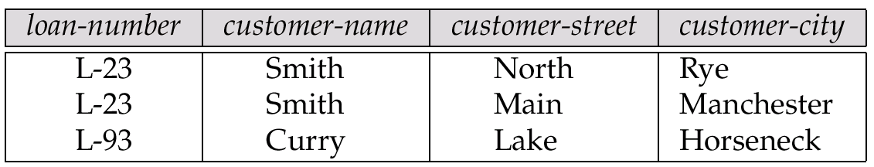
Relation bc: An Example of Reduncy in a BCNF Relation

Slide 90
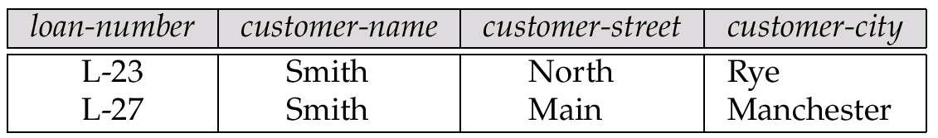
An Illegal bc Relation

Slide 91
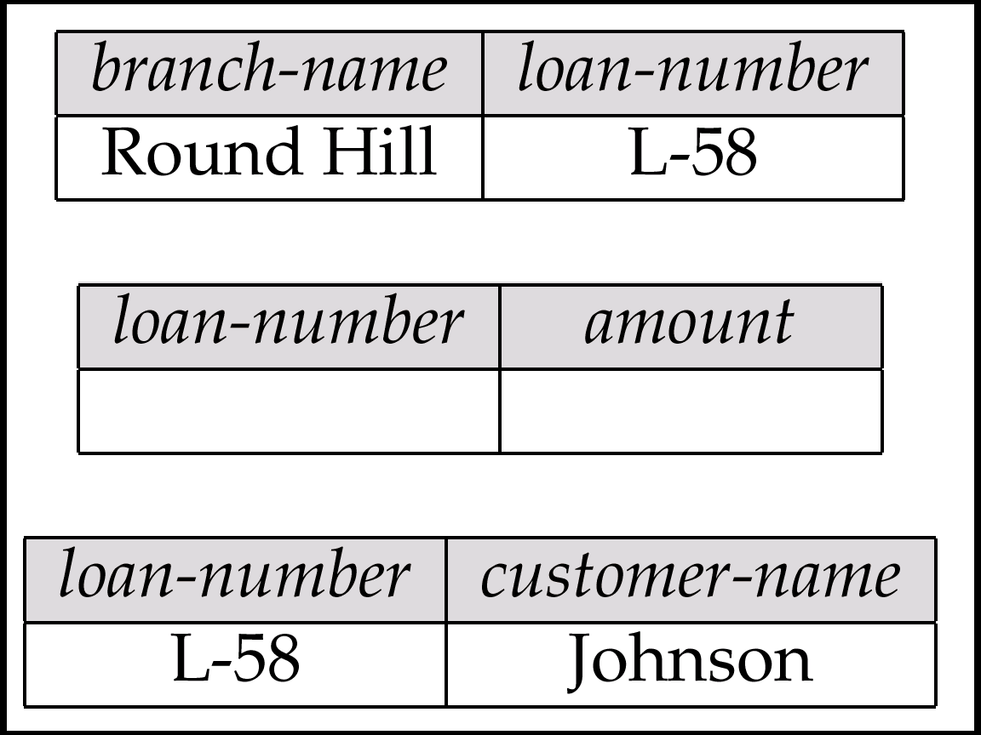
Decomposition of loan-info

Slide 92
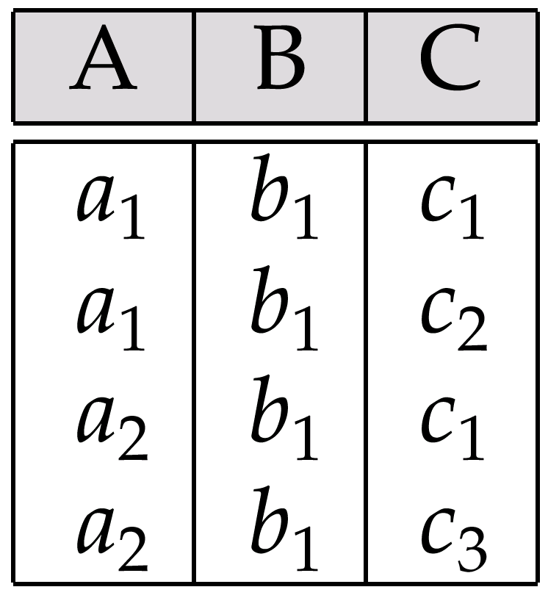
Relation of Exercise 7.4

